Slide 1


MATLAB & Simulink workshop
Made by: Youssef Ahmed

Slide 2

Session 2
Programming with MATLAB

Slide 3

Last session recap

Slide 4
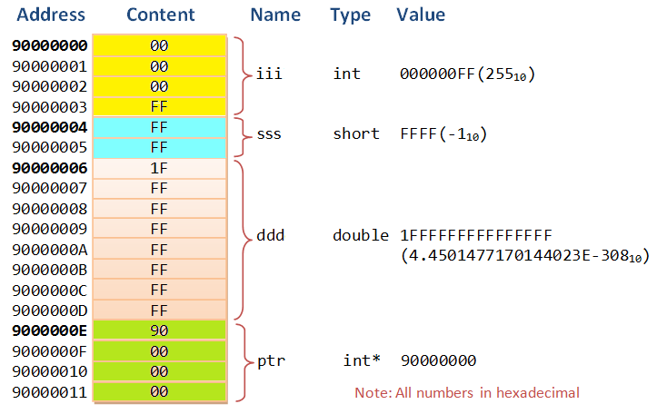
Variables
Introduction
What is a variable ?

Slide 5
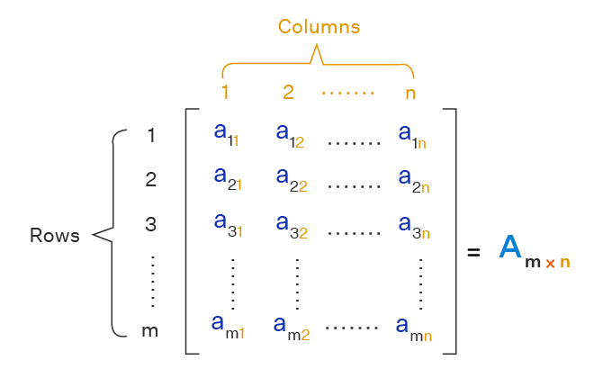
Variables
Introduction
Everything in MATLAB is a matrix

Slide 6
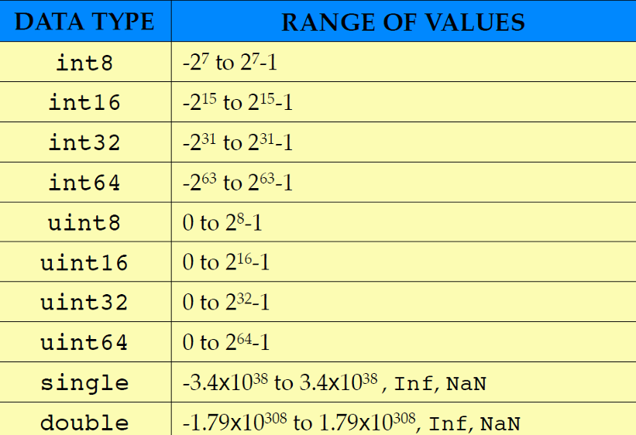
Variables
Data types
Different data types in MATLAB

Slide 7

MATLAB time!
Now let’s see what we covered so far in MATLAB

Slide 8

Operators
What does operator mean?
Types of operator in MATLAB
Arithmetic
Relational
Logical
Others

Slide 9
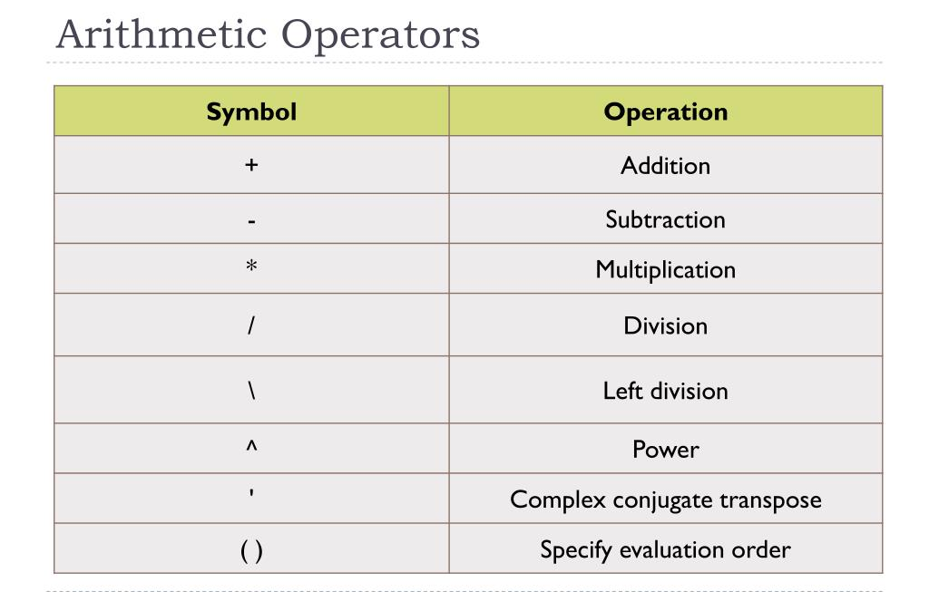
Operators
Arithmetic operators

Slide 10
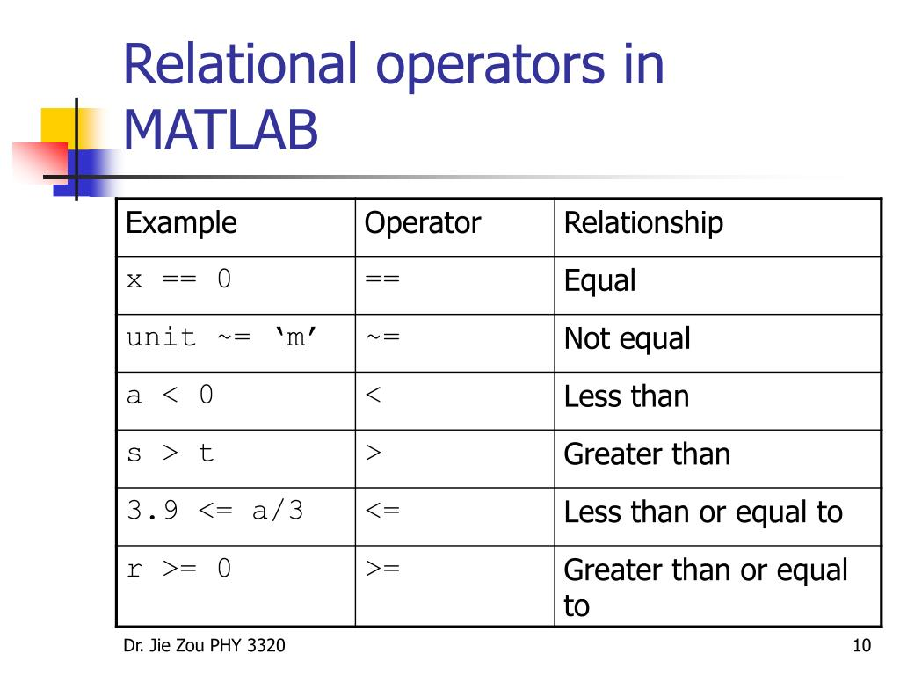
Operators
Relational operators

Slide 11
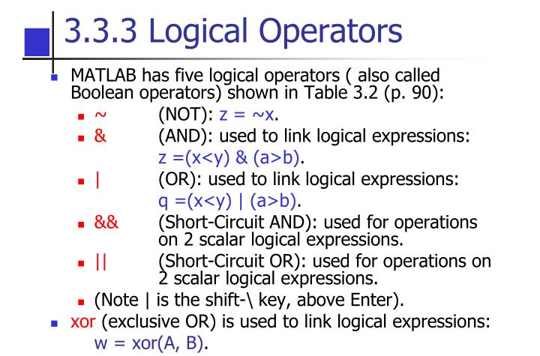
Operators
Logical operators

Slide 12
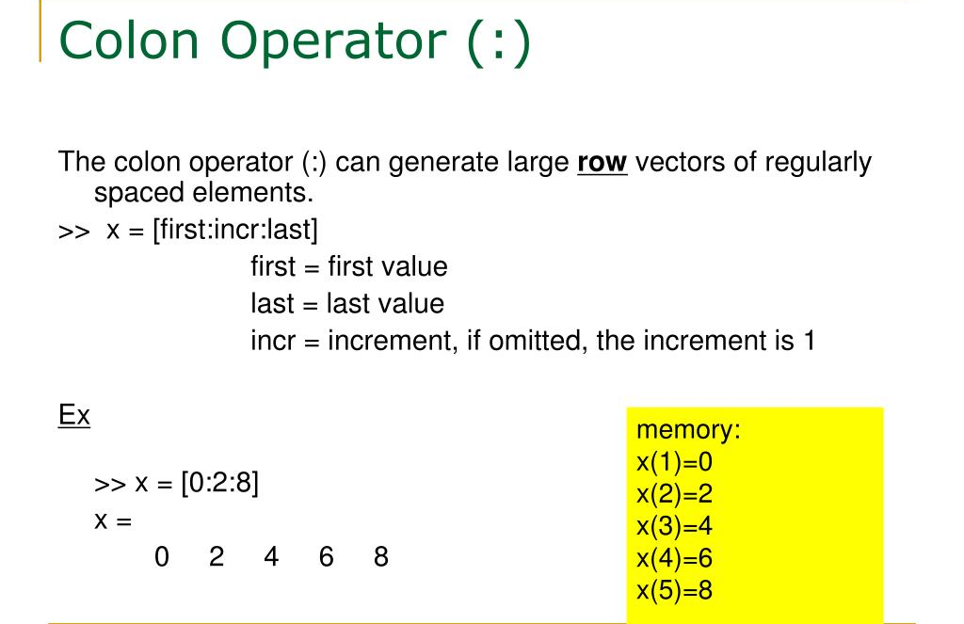
Operators
Other operators
Example of operator that is not arithmetic nor relational is the colon operator (:)

Slide 13
MATLAB time!
Now let’s see what we covered so far in MATLAB

Slide 14
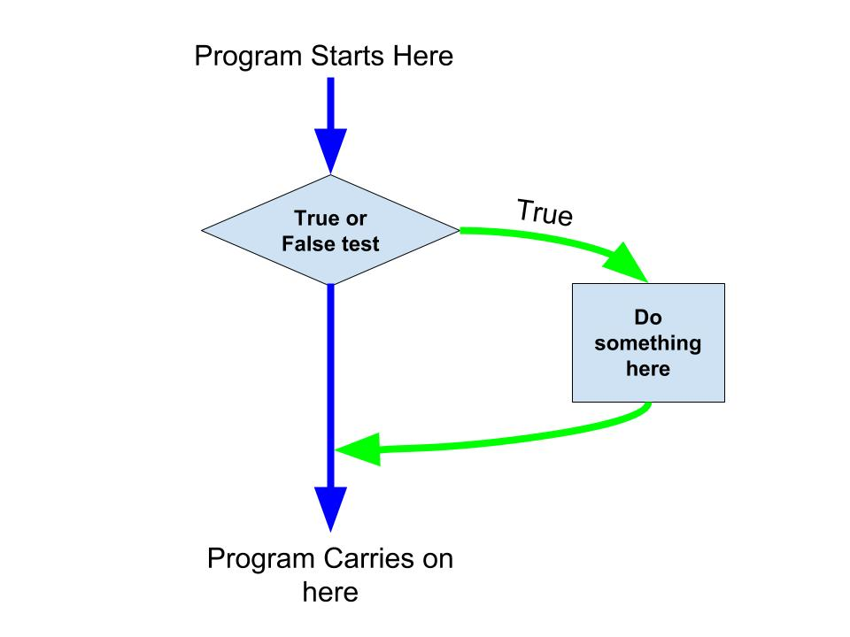
Control flow
If statement
What is if statement ?

Slide 15
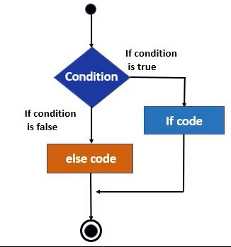
Control flow
If-else statement
What is if-else statement ?

Slide 16
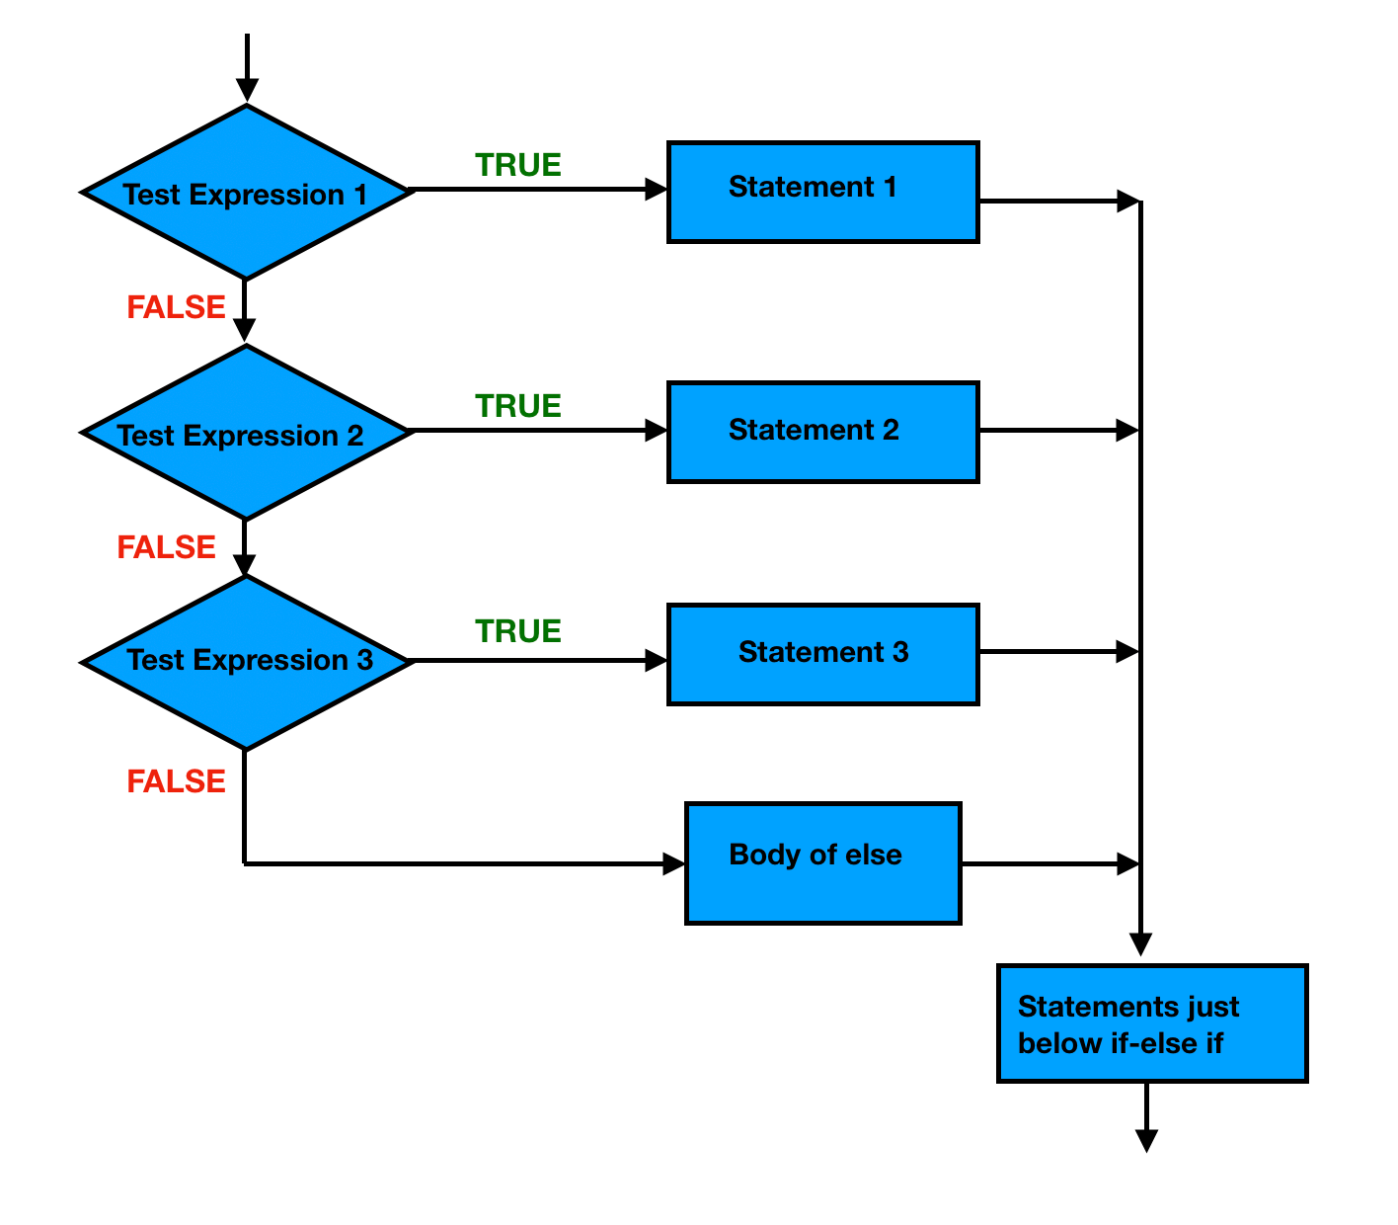
Control flow
Nested if-else statement
What is nested if-else statement ?

Slide 17
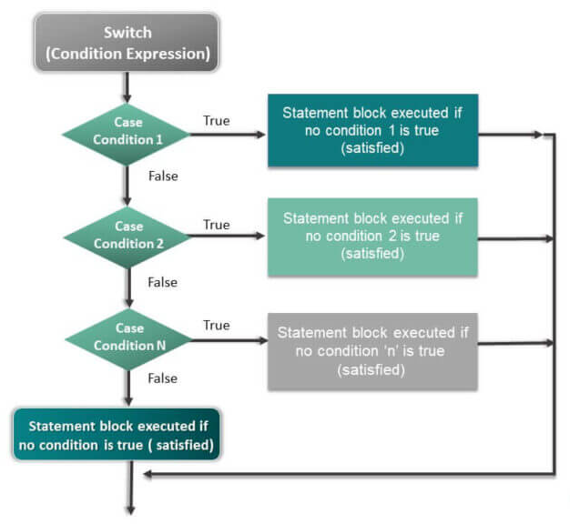
Control flow
Switch case
What is switch case ?

Slide 18
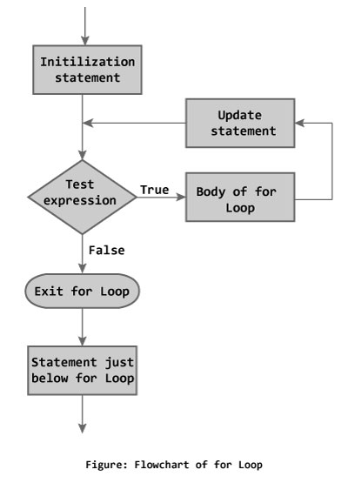
Control flow
For loop
What is for loop ?
What is it used for ?

Slide 19
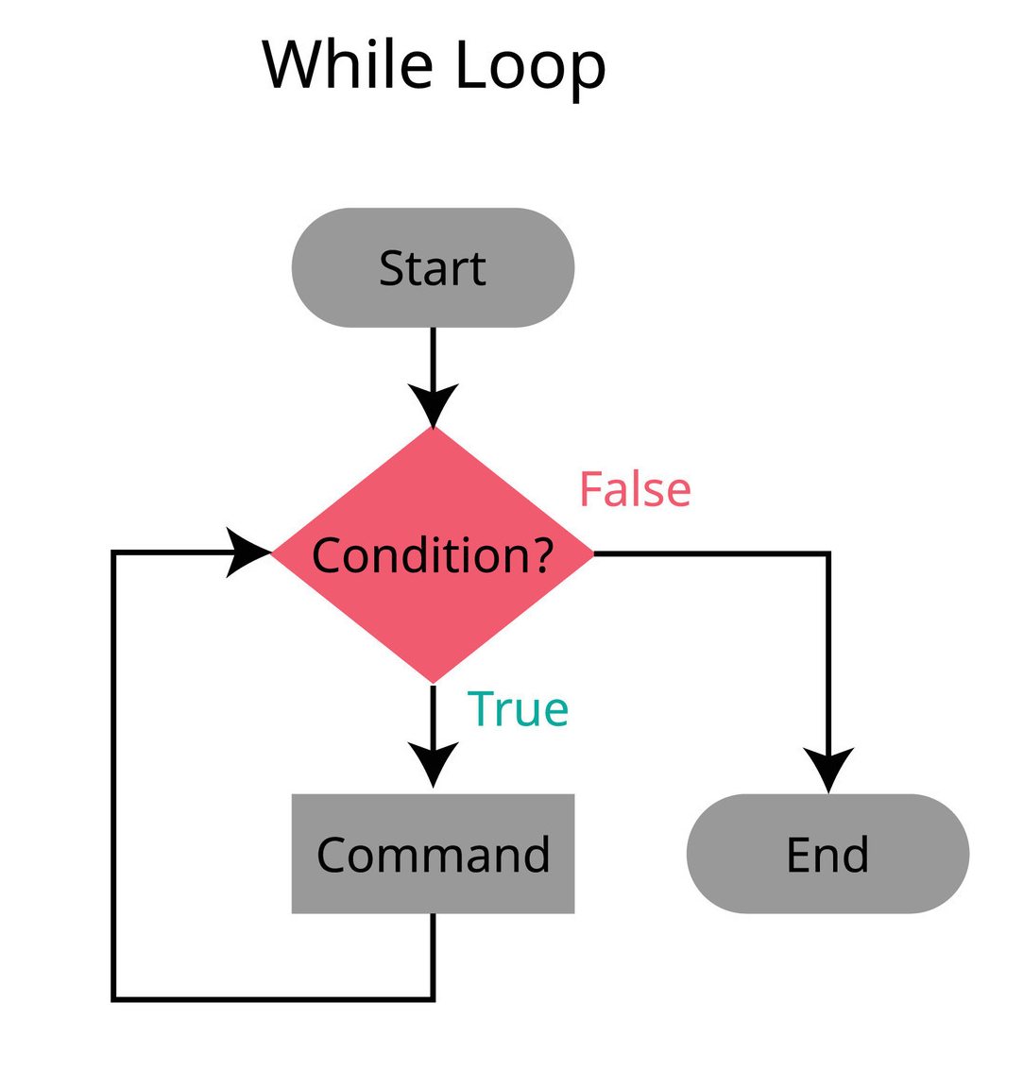
Control flow
While loop
What is while loop ?
What is it used for ?

Slide 20
MATLAB time!
Now let’s see what we covered so far in MATLAB

Slide 21
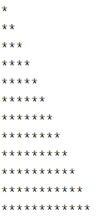
Problem solving
Left-aligned star pyramid
Try to generate this output for (n) number of rows

Slide 22
Problem solving
Is leap year
Check if a given year is a leap year or not A year is leap if it is:
divisible by 400, OR
divisible by 4 AND NOT divisible by 100

Slide 23
Task
You are required to submit one script (.m file) with the solution of the following three problems(Comment your code with franco :D)
1-Is valid date
the input is three variables: days, months, years check if the date is valid
Example: day =29 ;month =2; year=2023; ->invalid
Example: day =31 ;month =6; year=2023; ->invalid
Example: day =29 ;month =2; year=2024; ->valid

Slide 24
Task
You are required to submit one script (.m file) with the solution of the following three problems:
2-Leap year count
the input is two leap years you are required to count how many leap years between them including the two provided years

Slide 25
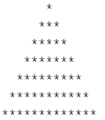
Task
You are required to submit one script (.m file) with the solution of the following three problems:
3-Star pyramid
the input is the number of rows, and the output is this upright pyramid shape

Slide 26
Thank you!

